Slide 1
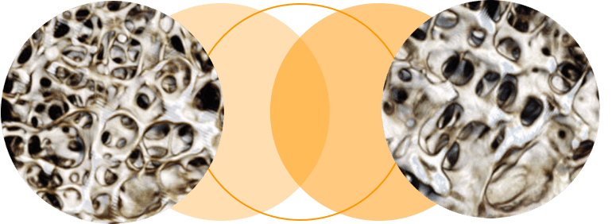
OSTEOPOROSIS
Mustafa Al-Badran
CABM FIBMS

Slide 2
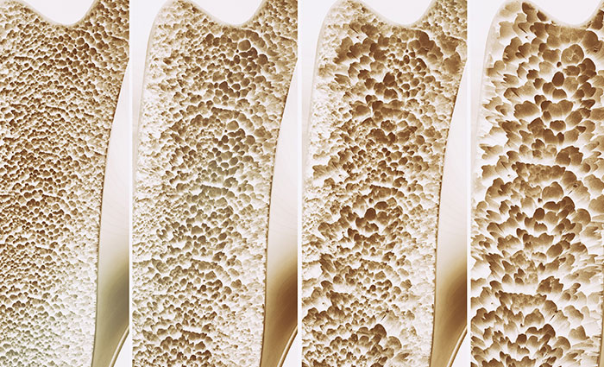
OSTEOPOROSIS
Reduced bone density, which causes micro-architectural deterioration of bone tissue and leads to an increased risk of fracture (fragility fractures)

Slide 3
Fragility Fractures
Defined as fractures result from falling from a standing height or less (occur spontaneously or following minimal trauma)
The most characteristic fragility fractures
Vertebrae
Hips
Humerus
Distal radius (Colles’ fracture)

Slide 4
Complications of osteoporotic fragility fractures
Vertebral fractures cause
Loss of height
Anterior kyphosis (Dowager’s Hump)
Reduced pulmonary function (each fracture decreases FVC by 9%)
Increased mortality rate
Approximately one-third of all vertebral fractures are painful, but two-thirds are asymptomatic

Slide 5
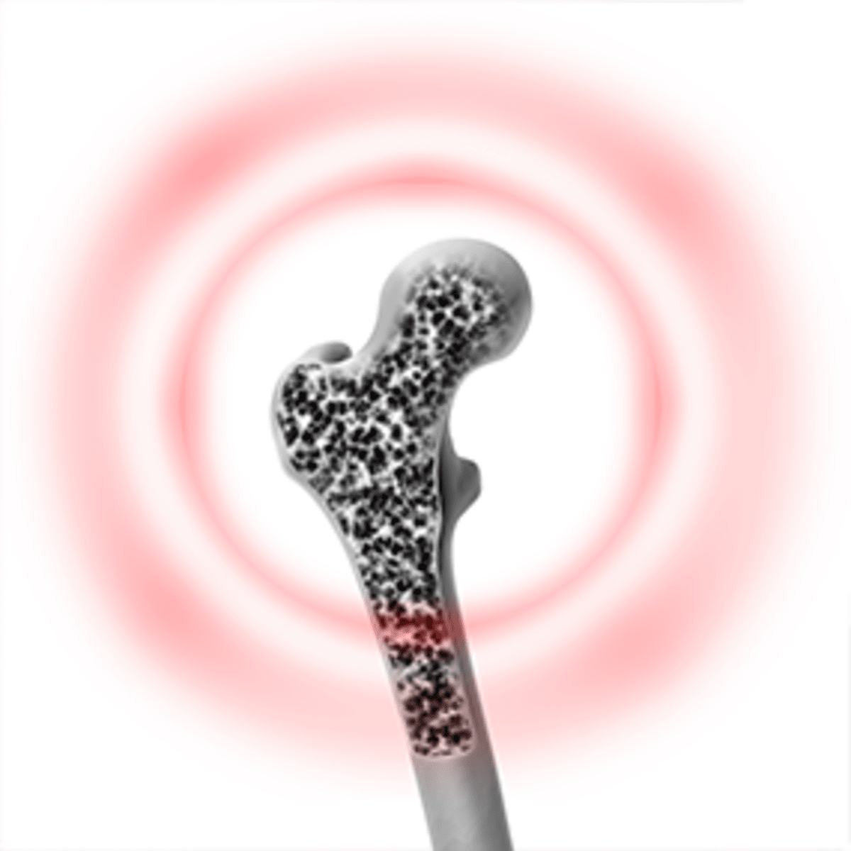
Idiopathic Osteoporosis
The occurrence of osteoporosis in patients with no specific underlying cause
Misleading Term since most patients in this category have
Age-related osteoporosis
Inheritance of genetic base

Slide 6
Secondary osteoporosis
Osteoporosis occur Secondary to a variety of diseases and drug treatments

Slide 7
The most important causes of secondary Osteoporosis
Genetic
Single Gene Mutation
(LRP5 Mutations)
Polygenic inheritance
Endocrine Diseases
Hypogonadism
Hyperthyroidism
Hyperparathyroidism
Cushing's Syndrome
Inflammatory Diseases
IBD
Rheumatoid arthritis
Ankylosing spondylitis
Drugs
Glucocorticoids
Thyroxine over replacement
Anticonvulsant
Thiazolidinediones
Alcohol intake > 3 U/day
Heparin
Gastrointestinal Disease
Malabsorption
Chronic Liver Disease
Lung Disease
COPD
Cystic Fibrosis
Miscellaneous
Multiple Myeloma
HIV
Anorexia Nervosa
Highly trained athletics
Heavy Smokers
Immobilization
BMI < 18

Slide 8
Male Osteoporosis
Fifty present of men with osteoporosis are with secondary cause
Predisposing factors of men osteoporosis
Hypogonadism
Glucocorticoid use
Alcohol excess

Slide 9
Glucocorticoid-Induced Osteoporosis
The risk of GIO is related to dose and duration of glucocorticoid therapy and increases in patients who have taken
More than 7.5 mg of prednisolone daily
For more than 3 months (or an equivalent dose of another glucocorticoid)
Notes:
Inhaled glucocorticoids can reduce bone density but the risk of osteoporosis is much lower than with systemic therapy.

Slide 10
Mechanism of GIO
Inhibiting bone formation by
Apoptosis of osteoblasts & osteocytes
Inhibition of intestinal calcium absorption
Increased renal excretion of calcium
Secondary hyperparathyroidism*
Notes:
*(stimulates osteoclastic bone resorption)

Slide 11
Pregnancy-Associated Osteoporosis
Rare form of osteoporosis of unknown cause*
Presents during the second or third trimester with
Back pain
Multiple vertebral fractures
Notes:
* May relate to an exaggeration of the bone loss that normally occurs during pregnancy in patients with pre-existing low bone mass

Slide 12
Clinical Features
Osteoporosis does not cause symptoms until a fracture occurs
Non-vertebral fractures are almost always caused by a traumatic event (usually a simple fall)
Clinical signs of fracture
Pain
Local Tenderness
Deformity

Slide 13
Hip fracture
Patient unable to weight-bear
Shortened and externally rotated limb
Vertebral fractures
Asymptomatic (height loss and kyphosis)
Radiological osteopenia or vertebral deformity on an X-ray performed for other reasons
Chronic back pain
Acute severe back pain radiate to the anterior chest or abdominal wall that may be mistaken for a
Myocardial infarction
Aortic dissection
Intra-abdominal pathology

Slide 14
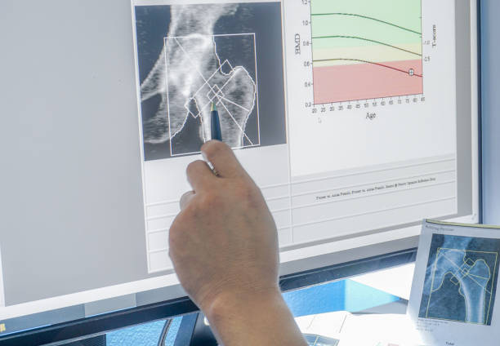
INVESTIGATIONS
DXA Scan
Indications for Dual X-Ray Absorptiometry (DXA)
Low-trauma fracture, age >50 years
Clinical risk factors and 10-year fracture risk >10%
Glucocorticoid therapy*
Assessment of response of osteoporosis to treatment
Assessment of progression of osteopenia to osteoporosis
Age <50 years and very strong risk factors for osteoporosis
Notes:
*(> 7.5 mg prednisolone daily for >3 months)

Slide 18
A 70 year old lady has been referred to the bone clinic following a low impact trauma fracture of her wrist. She is diagnosed as having osteoporosis. Which one of the following is her T-score?
-1.5 to -2.0
0 to -1.0
0 or above
-2.5 or below
-1.0 to -1.5
Answer is D Osteoporosis exists when the T-score is reduced by more than 2.5 standard deviations below that observed in young healthy adults.

Slide 21
Management
The aim of treatment is to reduce the risk of fracture
Non-pharmacological interventions
Smoking cessation
Moderation of alcohol intake
Adequate dietary calcium intake and exercise
Pharmacological interventions Several drug treatments are available to reduce the risk of fracture in osteoporosis

Slide 22
Bisphosphonates (First-line treatment for osteoporosis(
Bisphosphonates target bone surfaces and are ingested by osteoclasts during the process of bone resorption
Impairs bone resorption and increase in bone density due to increased mineralization of bone (not increase in bone mass)
Reduce the risk of fracture in patients with osteoporosis but do not completely prevent fractures occurring

Slide 24
Oral bisphosphonates given for a 5 years & if
NO fractures after 5 years
BMD levels have increased and no longer in the osteoporotic range
A 5-year spell off therapy
Continued for up to 10 years in patients whose BMD levels remain in the osteoporotic range after 5 years

Slide 25
Change treatment if BMD reduced more than 4% despite oral bisphosphonates
Switch to
Parenteral zoledronic acid
Teriparatide (TPTD)→(severe spinal osteoporosis)
Notes:
Intravenous zoledronic acid, 3 years of therapy is equivalent to 6 years in terms of fracture risk reduction and many experts recommend periods of 3 years on and 3 years off treatment to reduce the risk of over-suppression of bone turnover

Slide 26
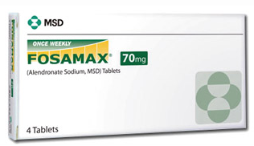
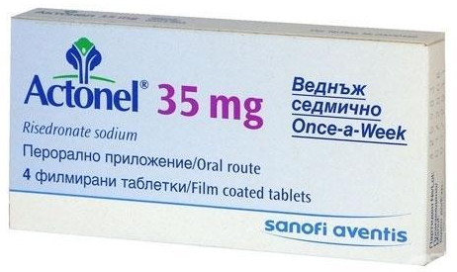
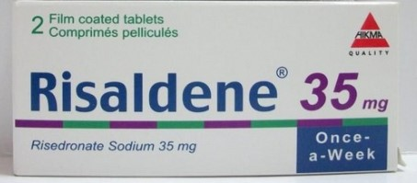
Oral bisphosphonates should be taken on an empty stomach with plain water; no food should be eaten for 30–45 minutes after administration
Contraindication
Oesophageal stricture or achalasia
Notes:
Oral bisphosphonates are poorly absorbed from the gastrointestinal tract and should be taken on an empty stomach with plain water; no food should be eaten for 30–45 minutes after administration.
Oesophageal stricture or achalasia(tablets may stick in the oesophagus, causing ulceration and perforation

Slide 27
Adverse effects of Bisphosphonates
Common
Upper gastrointestinal intolerance (oral)
Acute phase response (intravenous)
Less common
Atrial fibrillation (intravenous zoledronic acid)
Hypocalcaemia (intravenous)
A typical subtrochanteric fractures
Rare
Uveitis
Osteonecrosis of the jaw
Oesophageal ulceration
I.V bisphosphonates
Transient influenza-like illness occurs 24–48 hours after administration
Self-limiting but can be treated with paracetamol or NSAIDs
After the first exposure and tolerance develops thereafter
Notes:
Osteonecrosis of the jaw is characterised by the presence of necrotic bone in the mandible or maxilla, typically occurring after tooth extraction when the socket fails to heal. This complication is very rare in osteoporosis but patients receiving bisphosphonates should be advised to pay attention to good oral hygiene.
There is no evidence that temporarily stopping bisphosphonates for tooth extraction alters the risk of osteonecrosis of the jaw.
Atypical subtrochanteric fractures have been described in patients who have received long-term bisphosphonates and appear to be the result of over-suppression of normal bone remodeling.

Slide 28
Denosumab*
Monoclonal antibody that inhibits bone resorption by neutralizing the effects of RANKL
Subcutaneous injection of 60 mg every 6 months
Potential adverse effect
Hypocalcaemia (mitigated by calcium and vitamin D supplements)
Osteonecrosis of the jaw and atypical subtrochanteric fractures(Rare)
Notes:
*similar efficacy to zoledronic acid

Slide 29
Calcium and Vitamin D
Combined calcium and vitamin D supplements have limited efficacy in the prevention of osteoporotic fractures when given alone
Used as an adjunct to other treatments
Daily dosage is 1000 mg calcium and 800 IU vitamin D
Notes:
The response to bisphosphonates is blunted in patients with vitamin D deficiency so If the patient’s dietary calcium is sufficient, stand-alone vitamin D supplements (800 IU daily) can be prescribed as an adjunct to anti-osteoporosis therapies

Slide 30
Teriparatide (TPTD)
A 1-34 fragment of human PTH
Stimulating new bone formation
Self-administered S.C injection in a dose of 20 µg daily for 2 years
Should not combined with oral bisphosphonates
Adverse effects
Headache
Muscle cramps
Dizziness
Mild hypercalcaemia (asymptomatic and not require discontinuation of treatment)
Notes:
Although TPTD also stimulates bone resorption, the increase in bone formation is greater, resulting in increased bone density, particularly at sites rich in trabecular bone such as the spine.
Similar efficacy to that of bisphosphonates in prevention of non-vertebral fractures but it is superior to oral bisphosphonates in preventing vertebral fractures
Should not combined with oral bisphosphonates (since the bisphosphonate blunts the anabolic effect)

Slide 31
Abaloparatide
The 1-34 fragment of PTH-related protein
Stimulate bone formation
Self-administered injection of 80 µg daily for 18 months
Efficacy in prevention of vertebral fractures similar to TPTD
Adverse effects similar to those of TPTD
Notes:
At the end of this period an inhibitor of bone resorption should be given to maintain the increase in bone mass

Slide 32
Hormone replacement therapy
Cyclical HRT with Oestrogen and Progestogen prevents post-menopausal bone loss and reduces the risk of vertebral and non-vertebral fractures in postmenopausal women
Indicated
Women with an early menopause
Women with osteoporosis in their early fifties who have troublesome menopausal symptoms
Not recommended above the age of 60 because increase the risk of
Breast cancer
Cardiovascular disease
Venous thromboembolic disease

Slide 33
Raloxifene
Selective Oestrogen receptor modulator (SERM)
Partial agonist at Oestrogen receptors in bone and liver
Antagonist in breast and endometrium
Reducing the risk of vertebral fractures but not influence the risk of non-vertebral fracture
Adverse effects
Muscle cramps
worsening of hot flushes
Increased risk of venous thromboembolic disease
Bazedoxifene SERM (similar effects to raloxifene)

Slide 34
A 67 year old lady is referred to the bone clinic following a fractured wrist.
A DEXA scan is performed which shows a T-score of -2.0. She has no other osteoporotic risk factors.
Which one of the following treatments would you offer?
Lifestyle advice and vitamin D supplementation
Alendronic acid
HRT
Risedronate
No treatment
Answer is A. This patient has osteopenia since she has a T-score which falls between -1 and -2.5. Therefore, appropriate lifestyle changes such as exercise and vitamin D supplementation will be sufficient until she is reviewed further.

